Slide 1
Central Discovery Index (CDI)
Jean Dill

Slide 2
What is CDI?
How is availability determined?
How can we control availability?
Fully Flexible vs EasyActive
CDI Attributes
Troubleshooting

Slide 3
What is CDI?
How is availability determined?
How can we control availability?
Fully Flexible vs EasyActive
CDI Attributes
Troubleshooting

Slide 4
CDI and Alma in your Discovery System
Discovery
Delivery
Central Discovery Index
Includes ~4 billion citations
Accessible in both of Ex Libris' discovery systems
Most resources are free to search
Some A&I databases require a subscription to search
Linking to content via Alma
Full text content in its own database/repository
Direct linking or use of link resolver
May require authentication or authorization to access

Slide 5
How does this all work?
Content loaded into CDI

Slide 6
Content loaded into CDI
Patrons search index via Primo/Summon

Slide 7
Content loaded into CDI
Patrons search index via Primo/Summon
Receive results

Slide 8
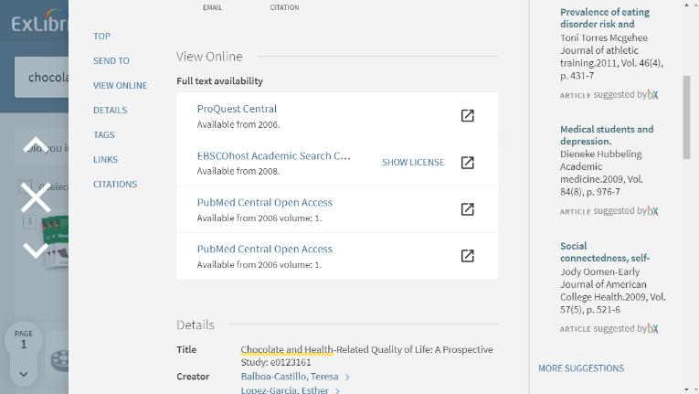
Content loaded into CDI
Patrons search index via Primo/Summon
Receive results
Access full text via links

Slide 9
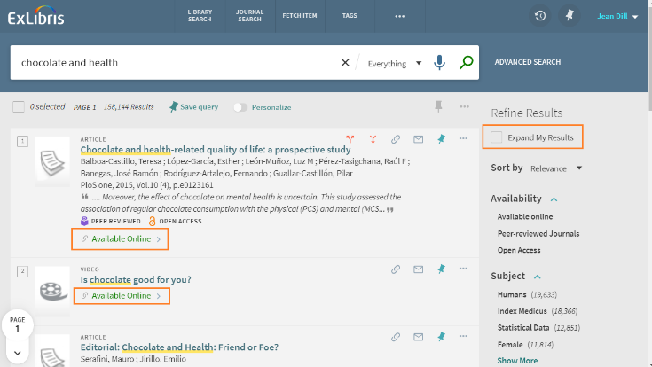
Primo Filtered Search (DEMO)
Results include all available resources (active in Alma)

Slide 10
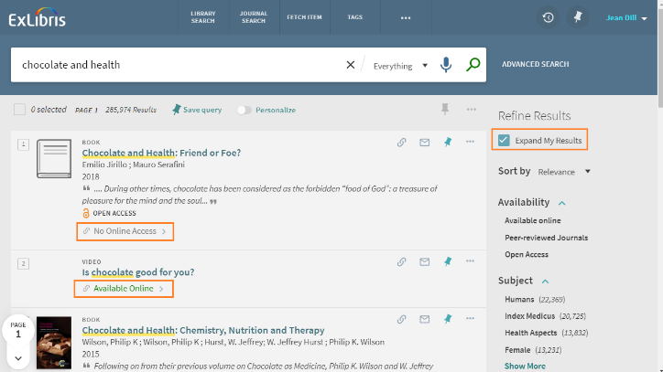
Primo Expanded Search (DEMO)
Results include all resources (including no full text) active in CDI

Slide 11
What is CDI?
How is availability determined?
How can we control availability?
Fully Flexible vs EasyActive
CDI Attributes
Troubleshooting

Slide 12
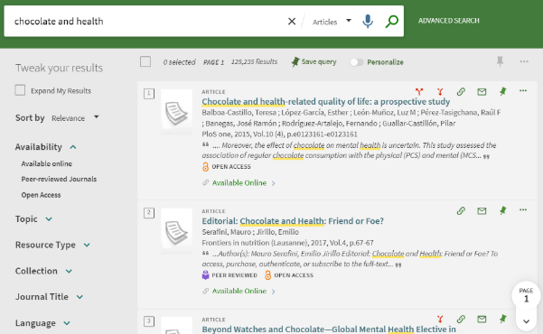
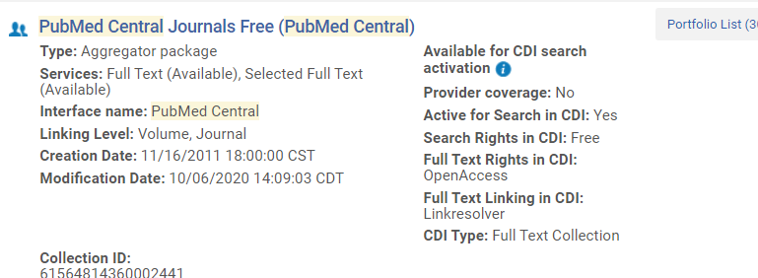
Citations for articles, book chapters, etc. from CDI

Slide 13
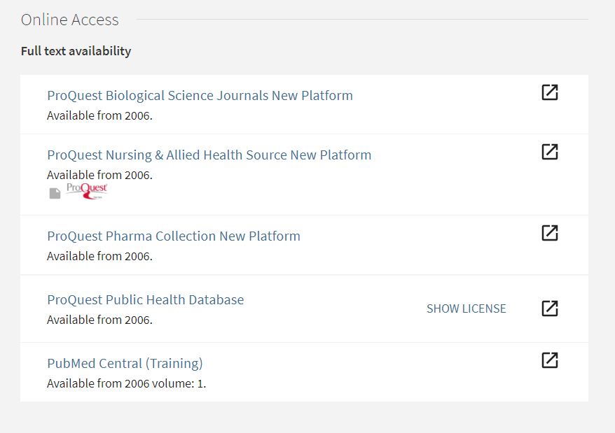
Links to the full text from Alma

Slide 14
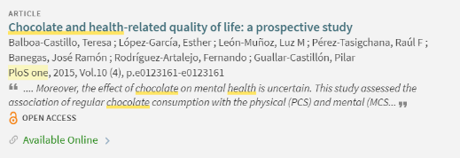
Availability Status
Active portfolios in electronic collections
Publishing includes identifiers and coverage
CDI matches relevant content and marks content as “Available Online”
Active databases (i.e. electronic collections w/o portfolios)
Publishing includes the collection’s ID (DBID)
CDI matches content based on the ID and mark all database content in CDI as ‘Available Online’

Slide 15
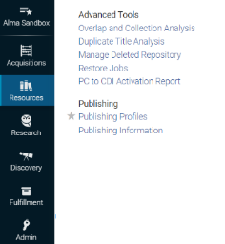
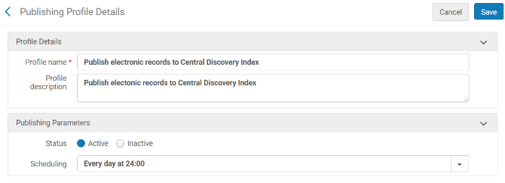
Publish Electronic Records to Central Discovery Index
Resources > Publishing > Publishing Profiles > Publish Electronic Records to CDI

Slide 16
What is CDI?
How is availability determined?
How can we control availability?
Fully Flexible vs EasyActive
CDI Attributes
Troubleshooting

Slide 17
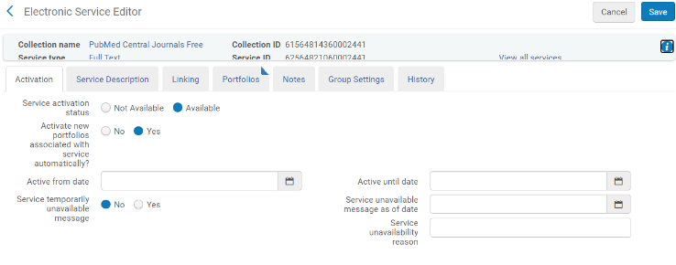
Activate/Deactivate collection in Alma
Shows as ‘unavailable’ in search results
Links to full text will not appear in full record

Slide 18
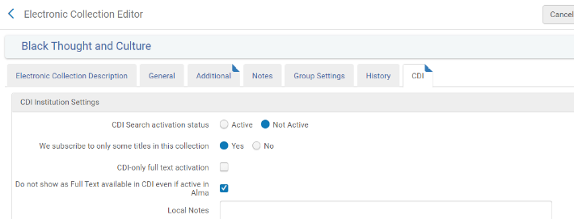
Setting: Do not show as Full Text available in CDI even if active in Alma’
If collection is active in Alma you have the option to NOT mark the content as ‘Available Online’ in CDI
Shows as ‘unavailable’ in search results
Links to full text will still appear in full record

Slide 19
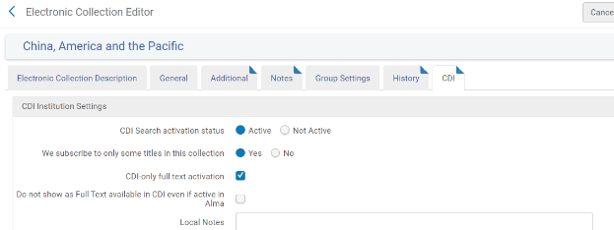
Setting: ‘CDI Only Full Text Activation’
If collection is INACTIVE in Alma you can mark it as ‘Available Online’ only in CDI
Shows as ‘Available’ in search results
Direct link to full text will appear in full record
For collections that use the link in record rather than the link resolver

Slide 20
Setting: ‘We subscribe to only some titles in this collection = No’
If collection is Active in Alma you have the option to mark the entire collection content as ‘Available Online’ in CDI regardless of the portfolio’s activation in Alma
For collections that use the link in record rather than the link resolver

Slide 21
Use Case – Handling Duplicate eBooks in CDI results
Suppress the eBook records from being published to CDI using Do not show…
Pro: uses your local bib records
Con: book chapters, book reviews, etc. will not be flagged as available online
Suppress the bib records to be published to your local Primo index (Full text in CDI only activation option)
Pro: book chapters, book reviews, etc. will be flagged as available online
Con: only works with collections that use the Link in Record
Con: doesn’t use local bib records

Slide 22
What is CDI?
How is availability determined?
How can we control availability?
Fully Flexible vs EasyActive
CDI Attributes
Troubleshooting

Slide 23
Fully Flexible and Easy Active Settings
Fully Flexible
Setting is like search activations in Primo Central
Content that is set to full text available in Alma is automatically searchable in CDI regardless of your search activation settings for the collection
You can enable search for content that is not full text available in Alma
EasyActive
Majority of the collections in CDI are searchable
Exceptions include collections that require a subscription to search (i.e. A&I databases)

Slide 24
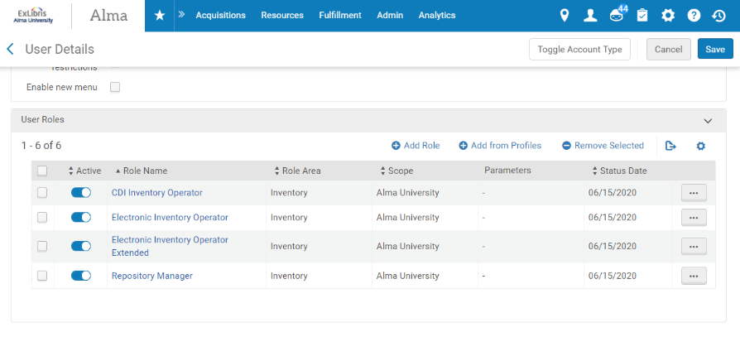
User roles
CDI Inventory Operator: Able to activate/change Central Discovery Index resources and settings
Electronic Inventory Operator/Extended: Able to activate/deactivate e-resources, add local electronic collections and portfolios, and create and manage sets. With the extended role, able to delete electronic inventory as well.
Repository Manager: Able to add/edit/delete notes, create/remove blocks, manage inventory operators, assign e-resource activations to operators, manage inventory and repository jobs, and add/edit/delete and link inventory in the MD Editor

Slide 25
What is CDI?
How is availability determined?
How can we control availability?
Fully Flexible vs EasyActive
CDI Attributes
Troubleshooting

Slide 26
CDI Attributes (DEMO)
In Advanced Search
In Brief Record
In CDI tab

Slide 27
What is CDI?
How is availability determined?
How can we control availability?
Fully Flexible vs EasyActive
CDI Attributes
Troubleshooting

Slide 28
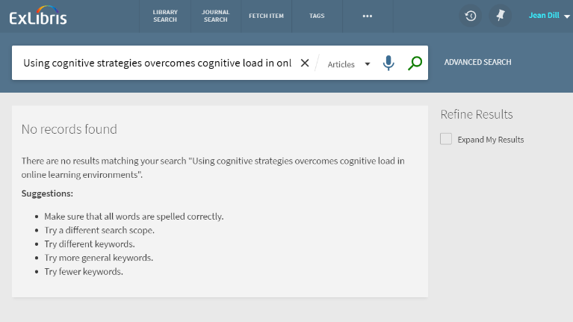
Why can’t I find the article I’m looking for?

Slide 29
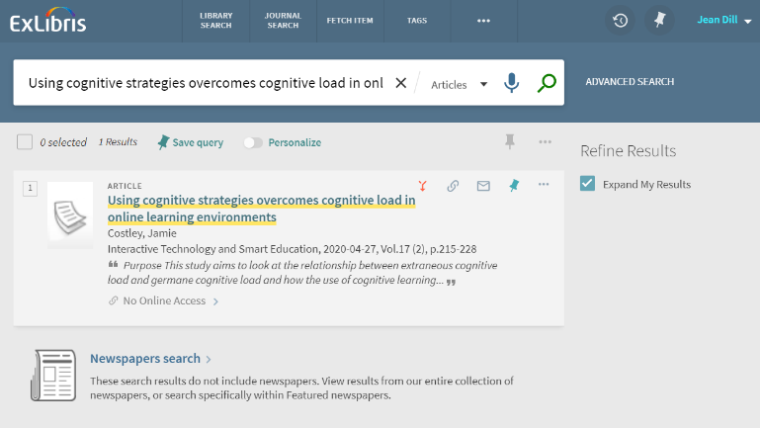
Expanded search includes the article, but it’s ‘No Online Access’

Slide 30
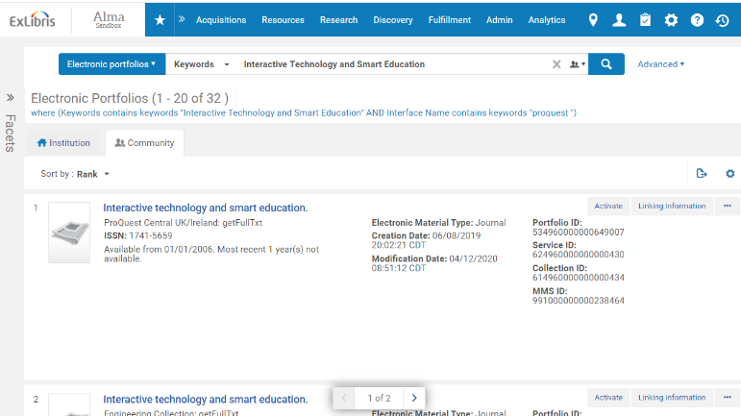
Activate the collection/portfolio, confirm the coverage dates

Slide 31
Expanded search doesn’t includes the article either

Slide 32
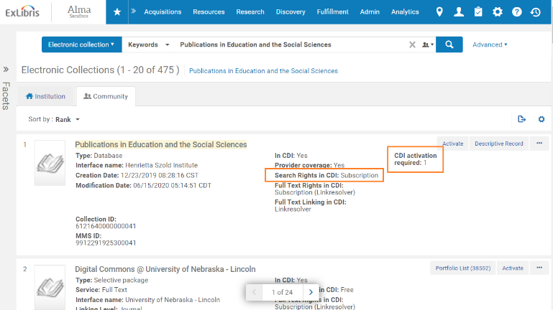
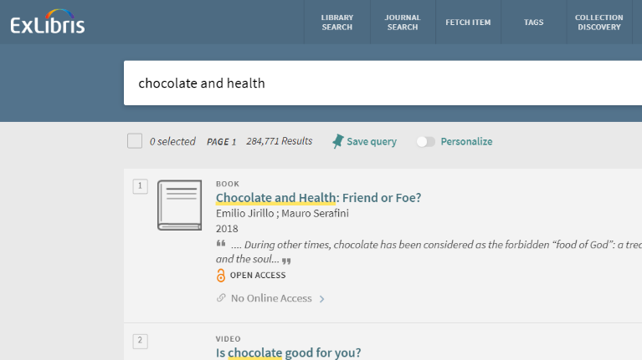
It’s active in CDI and Alma, why can’t I see it yet in the discovery system?

Slide 33
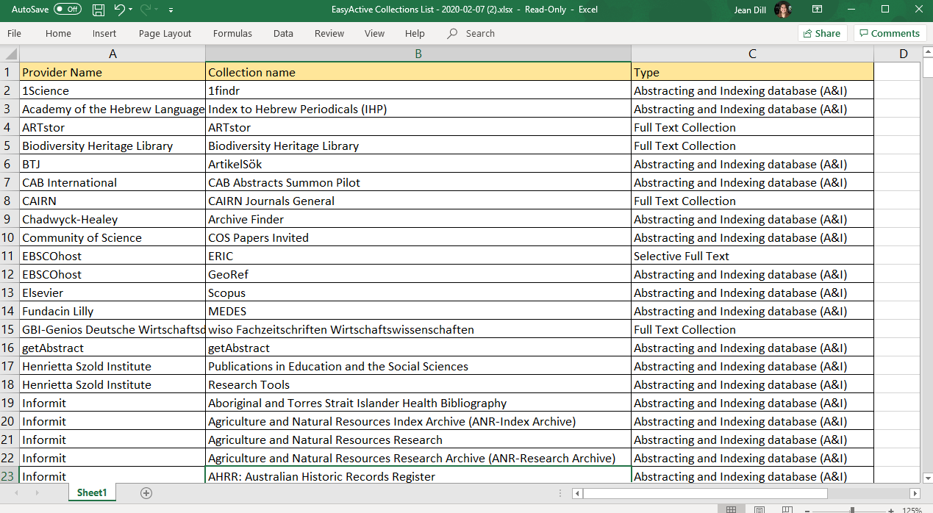
The EasyActive Collections List in the Knowledge Center
EasyActive Collections List

Slide 34
When I click on the full text link, I’m getting prompted to log in

Slide 35
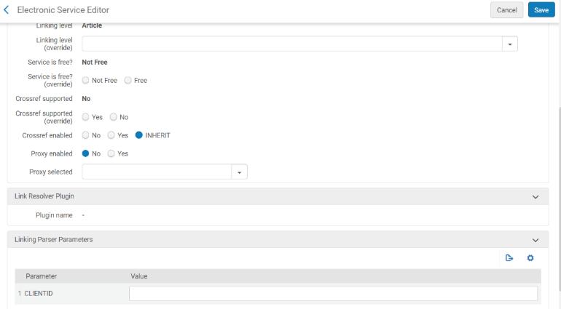
In Alma: check the service level proxy

Slide 36
In Alma: check the linking parameters

Slide 37
Thank you!

Slide 38
Knowledge Center Resources
Central Discovery Index (documentation and training)

